Slide 1
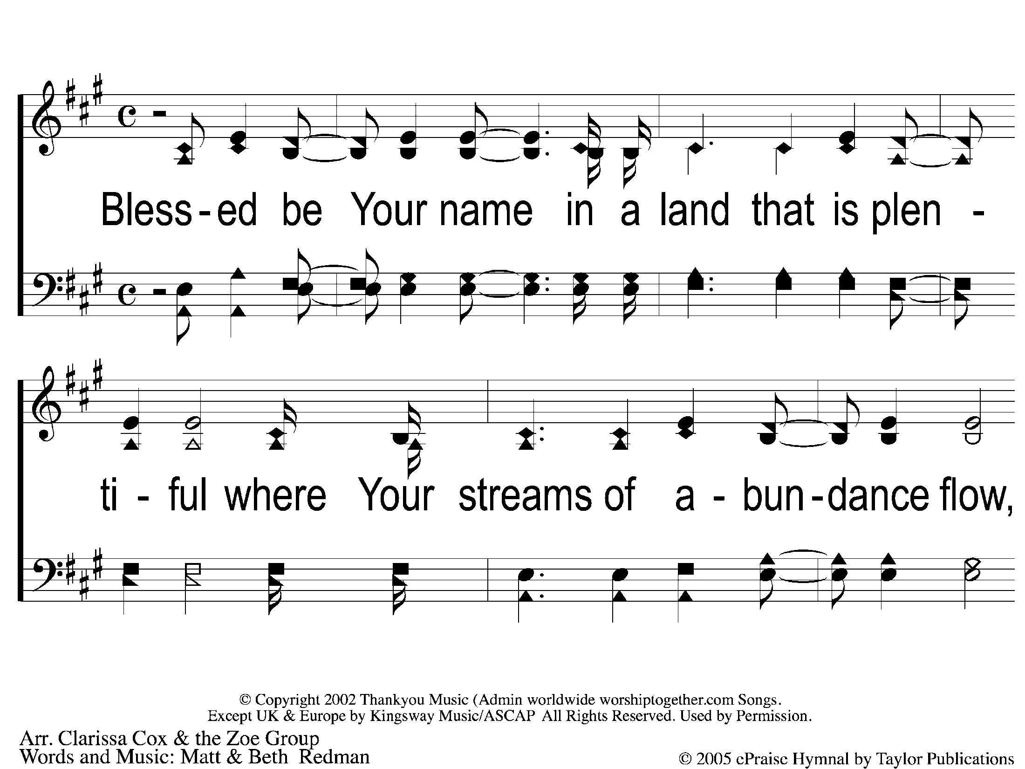
1-1 Blessed Be Your Name
Blessed be Your Name

Slide 2
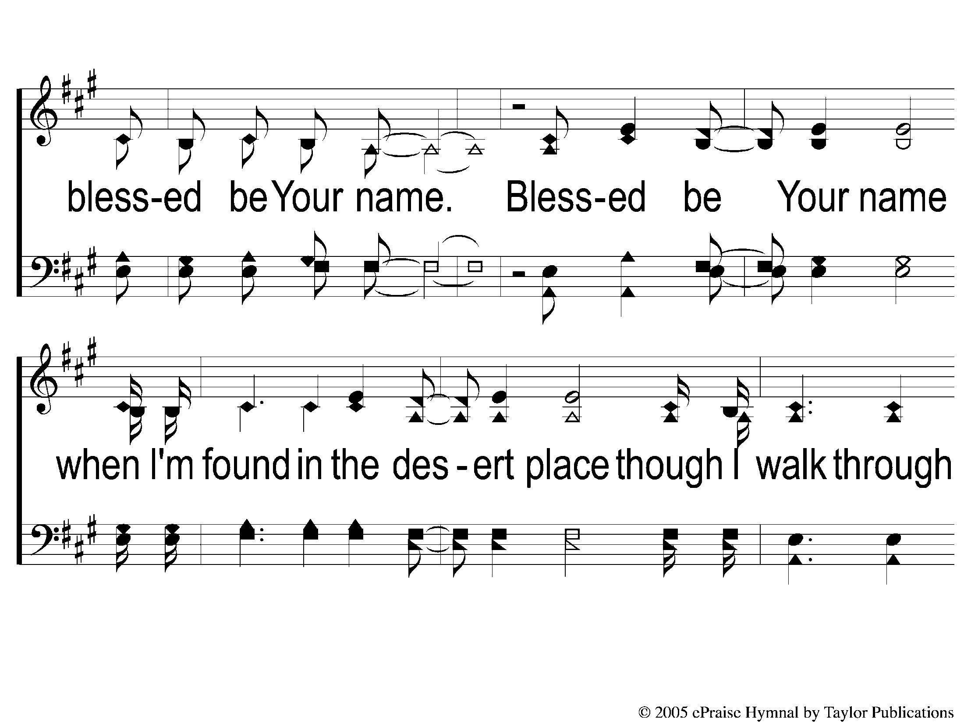
1-2 Blessed Be Your Name
Blessed be Your Name

Slide 3
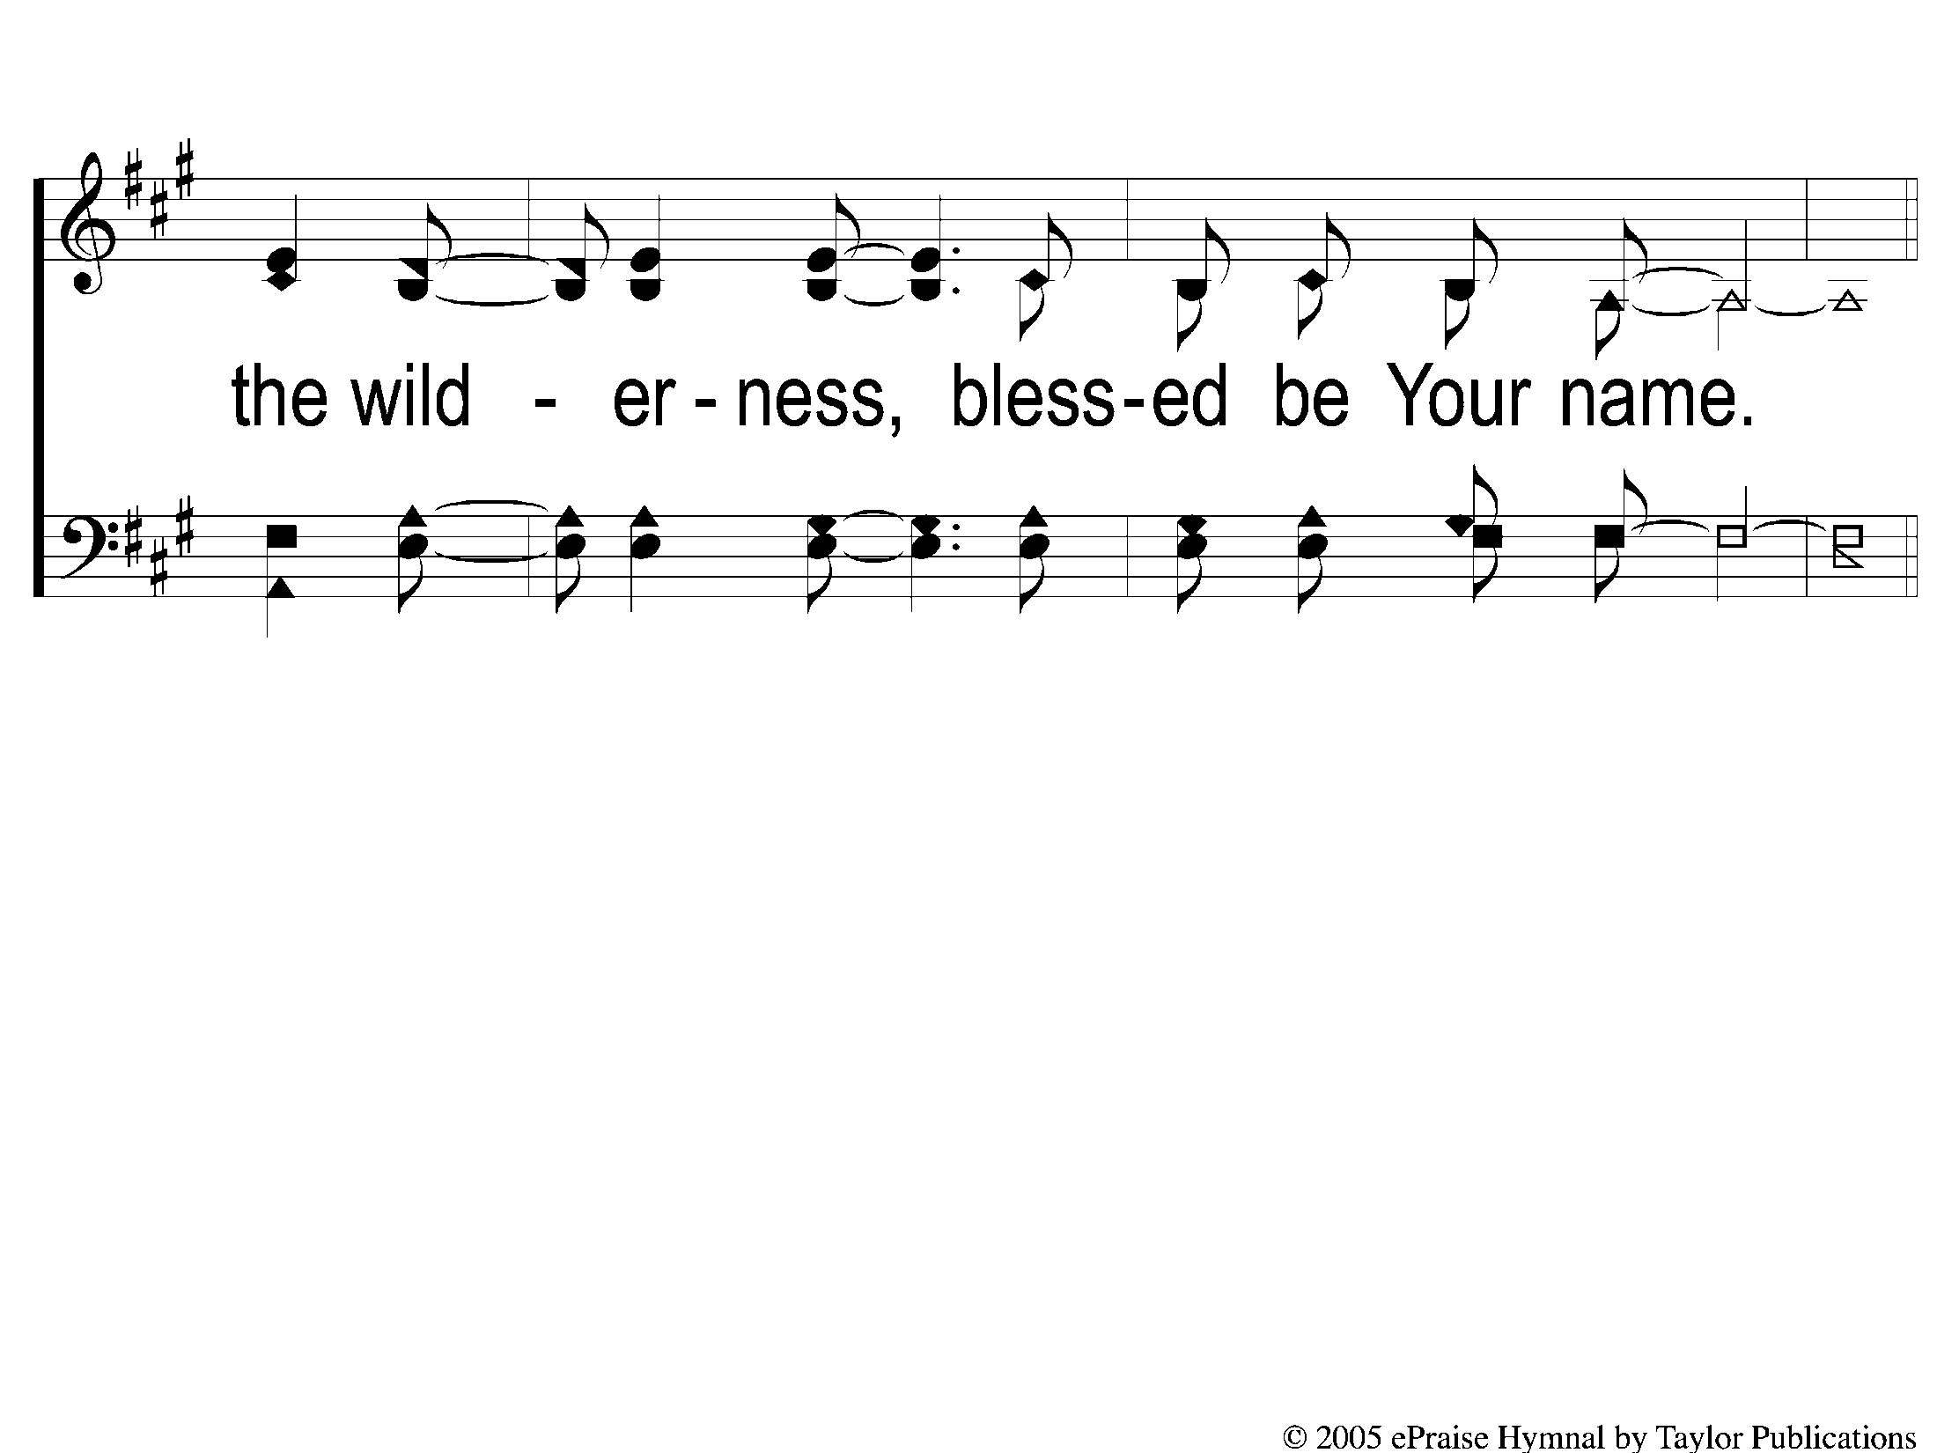
1-3 Blessed Be Your Name
Blessed be Your Name

Slide 4
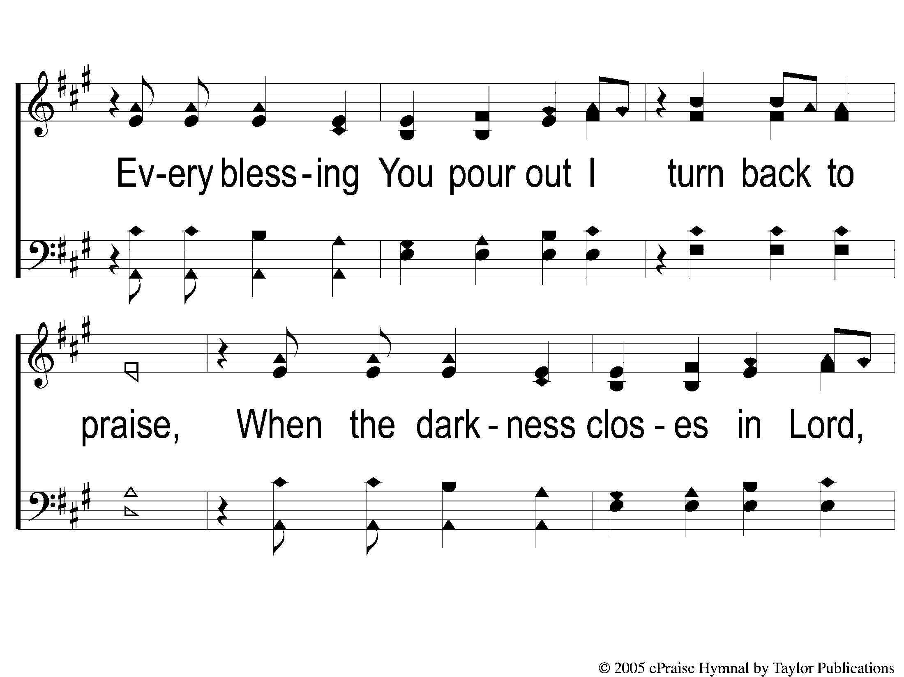
C-1 Blessed Be Your Name
Blessed be Your Name

Slide 5
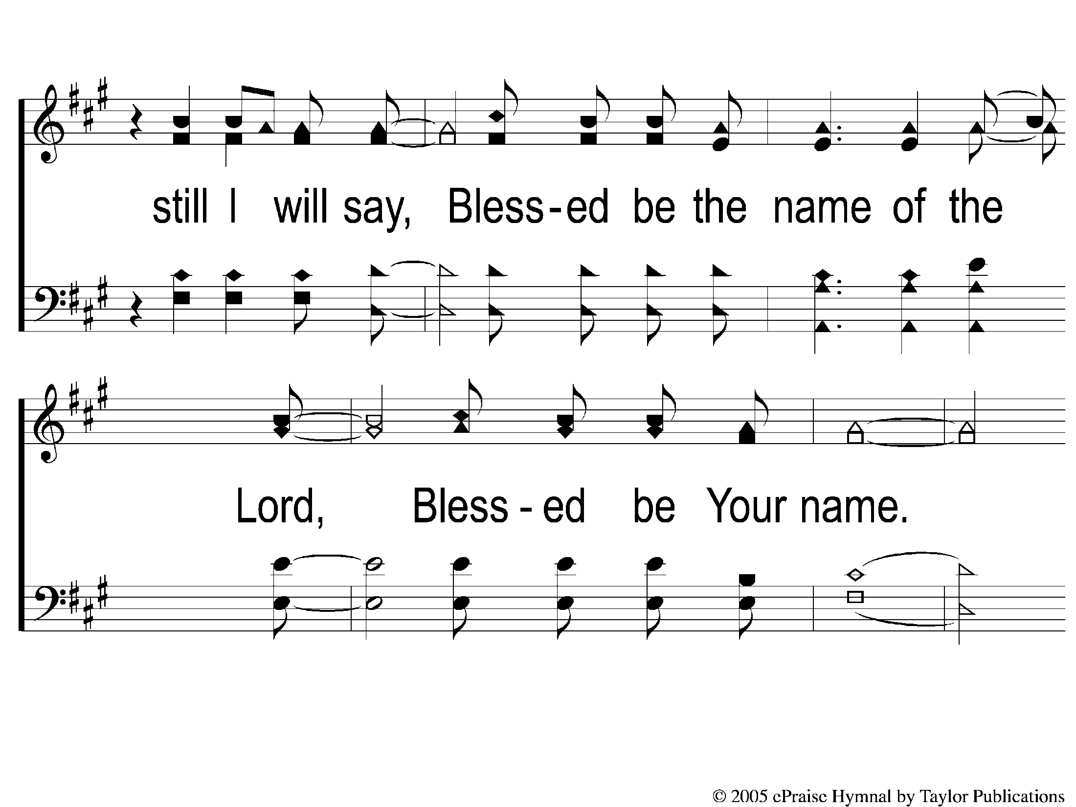
C-2 Blessed Be Your Name
Blessed be Your Name

Slide 6
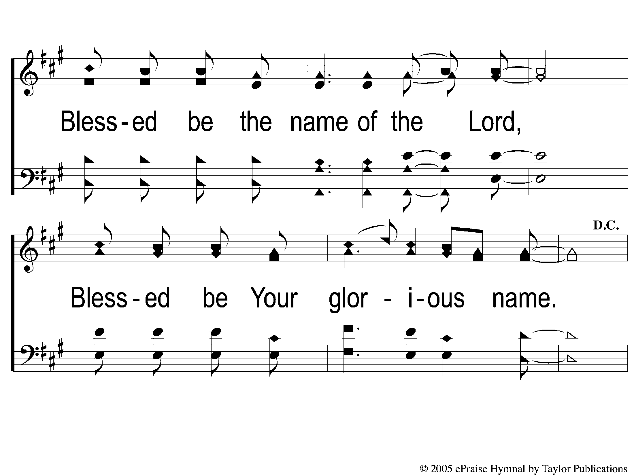
C-3 Blessed Be Your Name
Blessed be Your Name

Slide 7
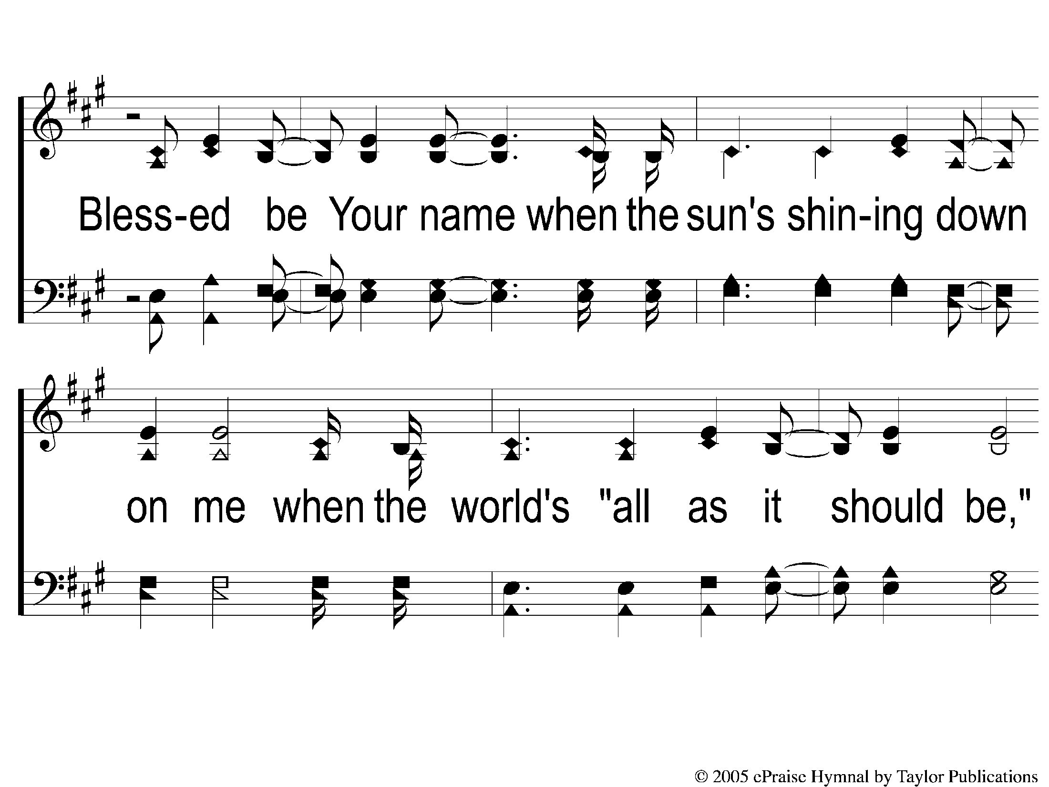
2-1 Blessed Be Your Name
Blessed be Your Name

Slide 8
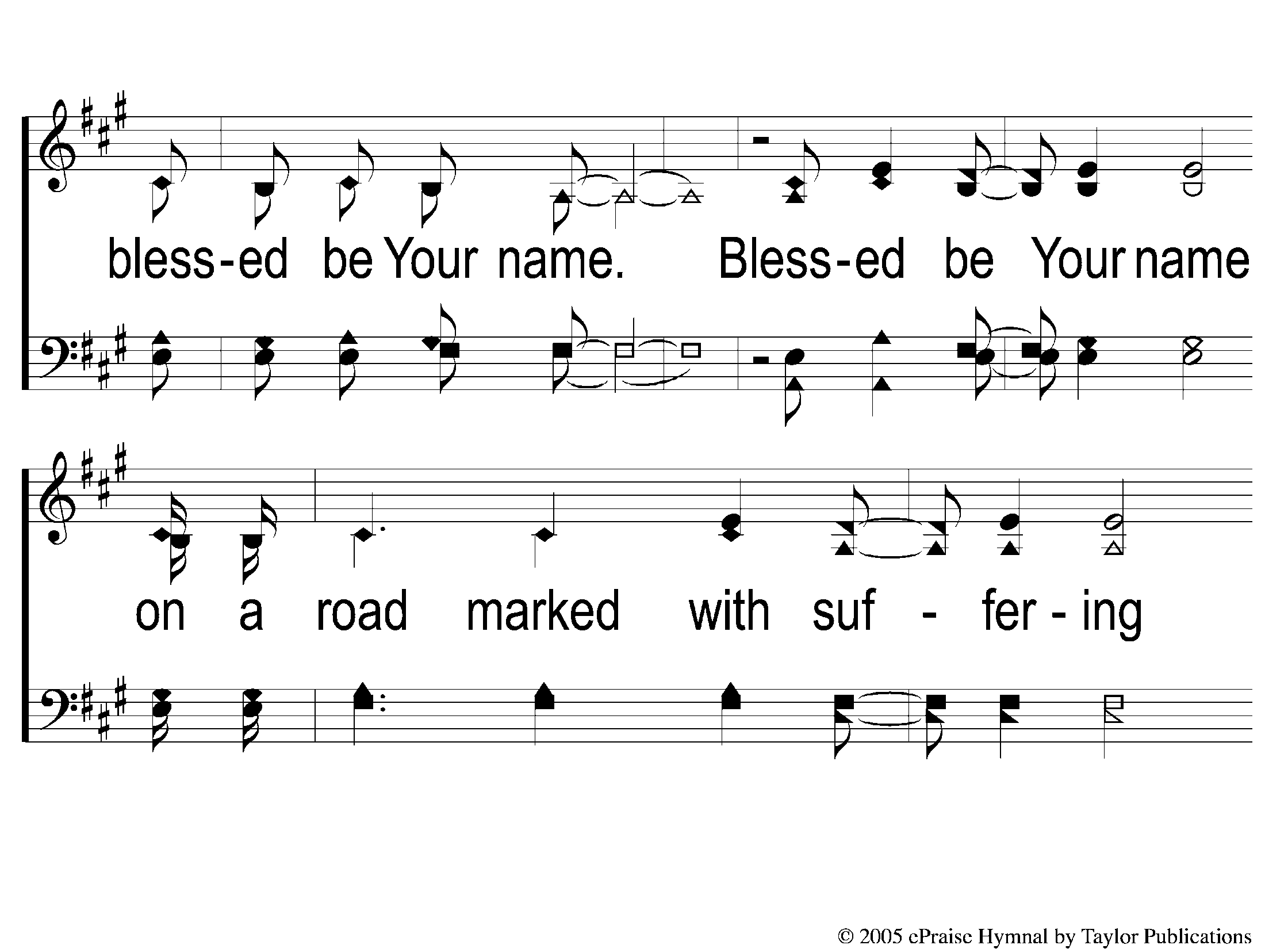
2-2 Blessed Be Your Name
Blessed be Your Name

Slide 9
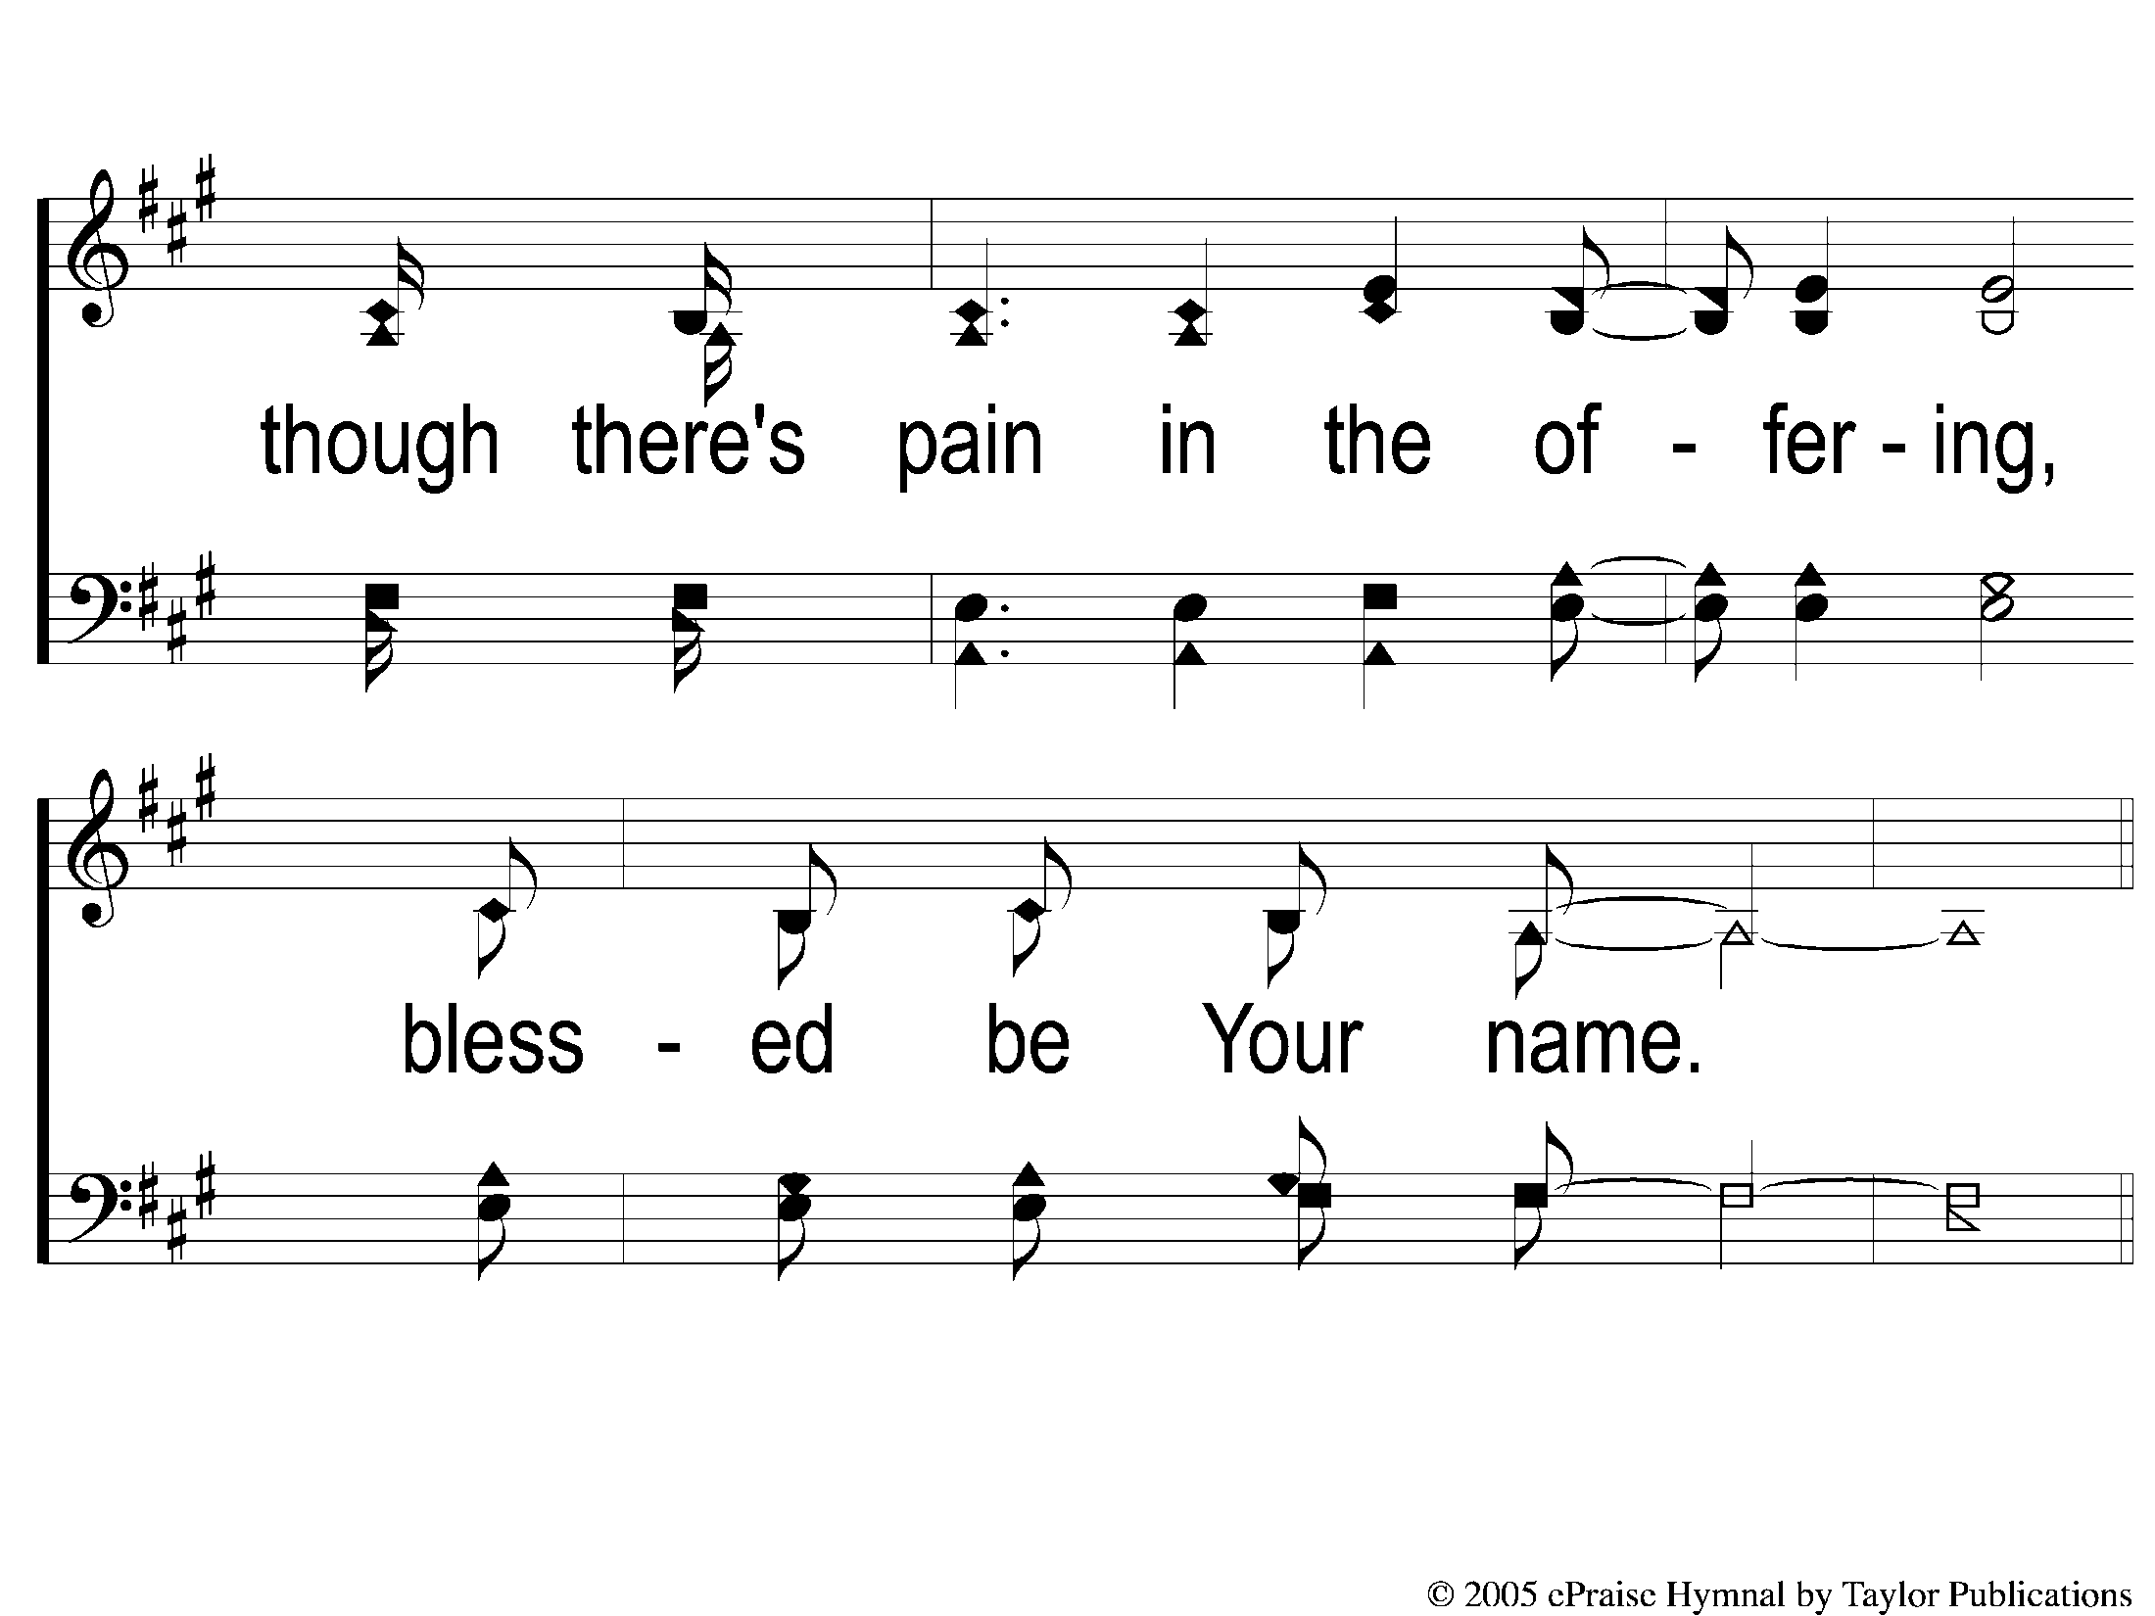
2-3 Blessed Be Your Name
Blessed be Your Name

Slide 10
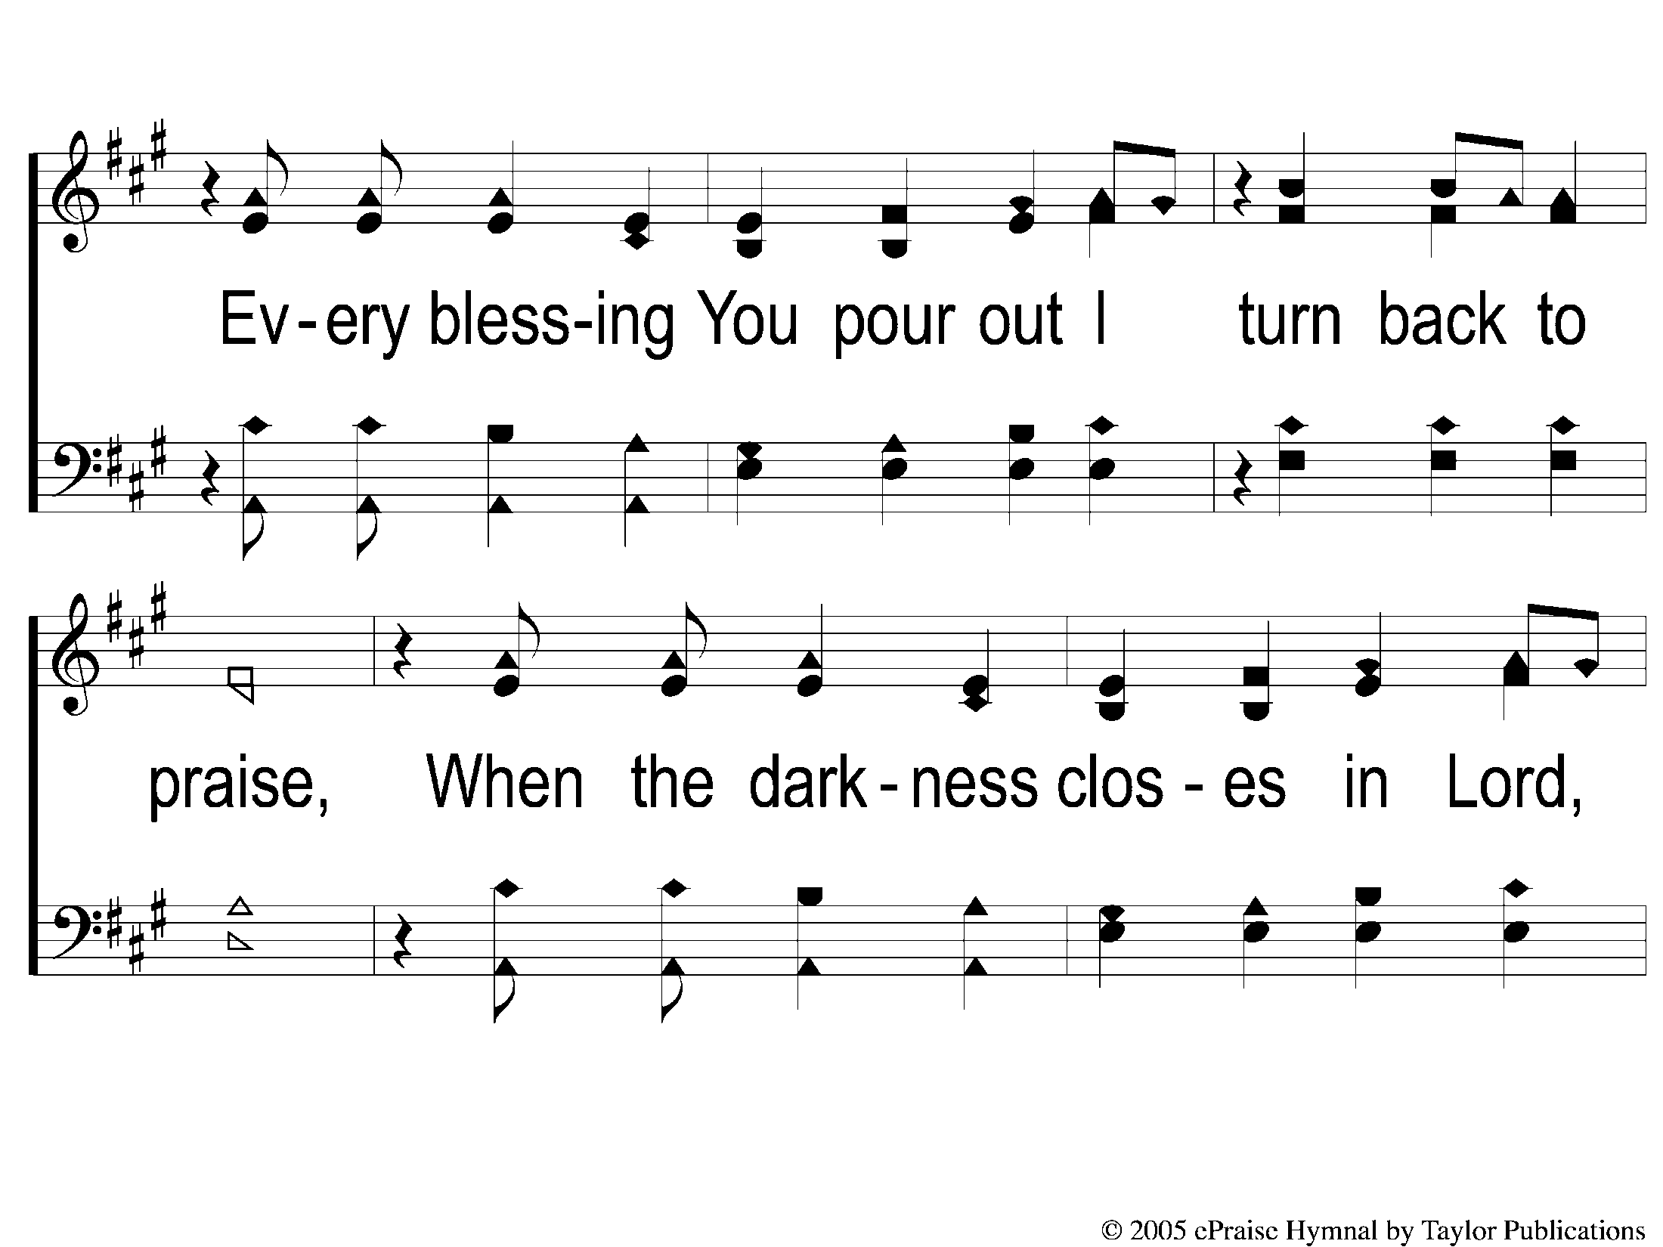
2C-1 Blessed Be Your Name
Blessed be Your Name

Slide 11
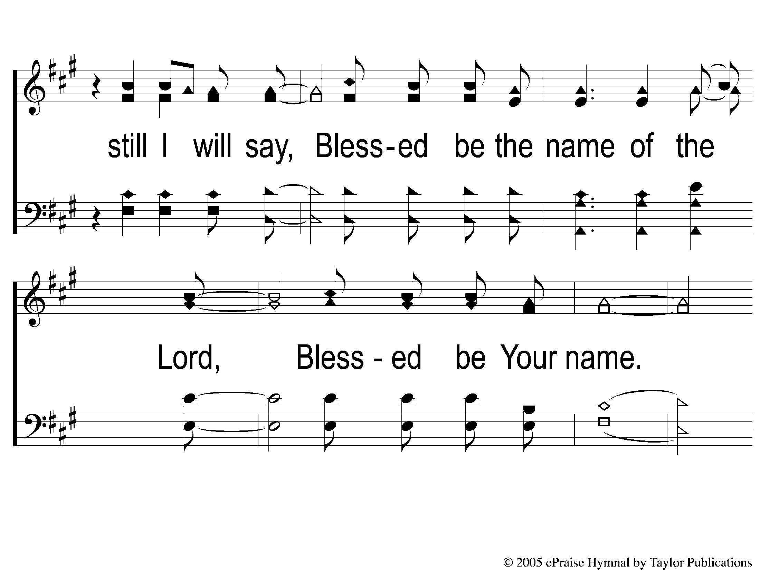
2C-2 Blessed Be Your Name
Blessed be Your Name

Slide 12
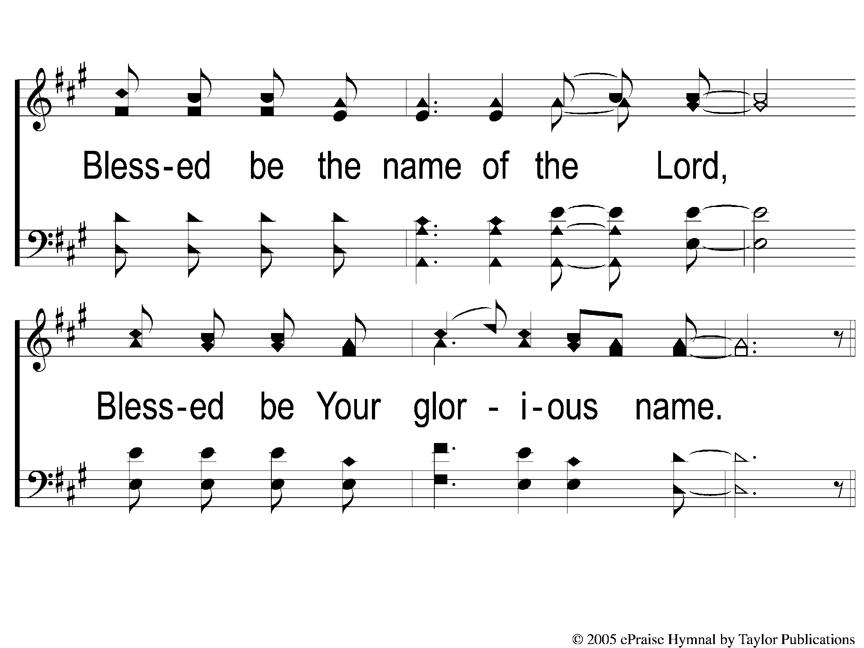
2C-3 Blessed Be Your Name
Blessed be Your Name

Slide 13
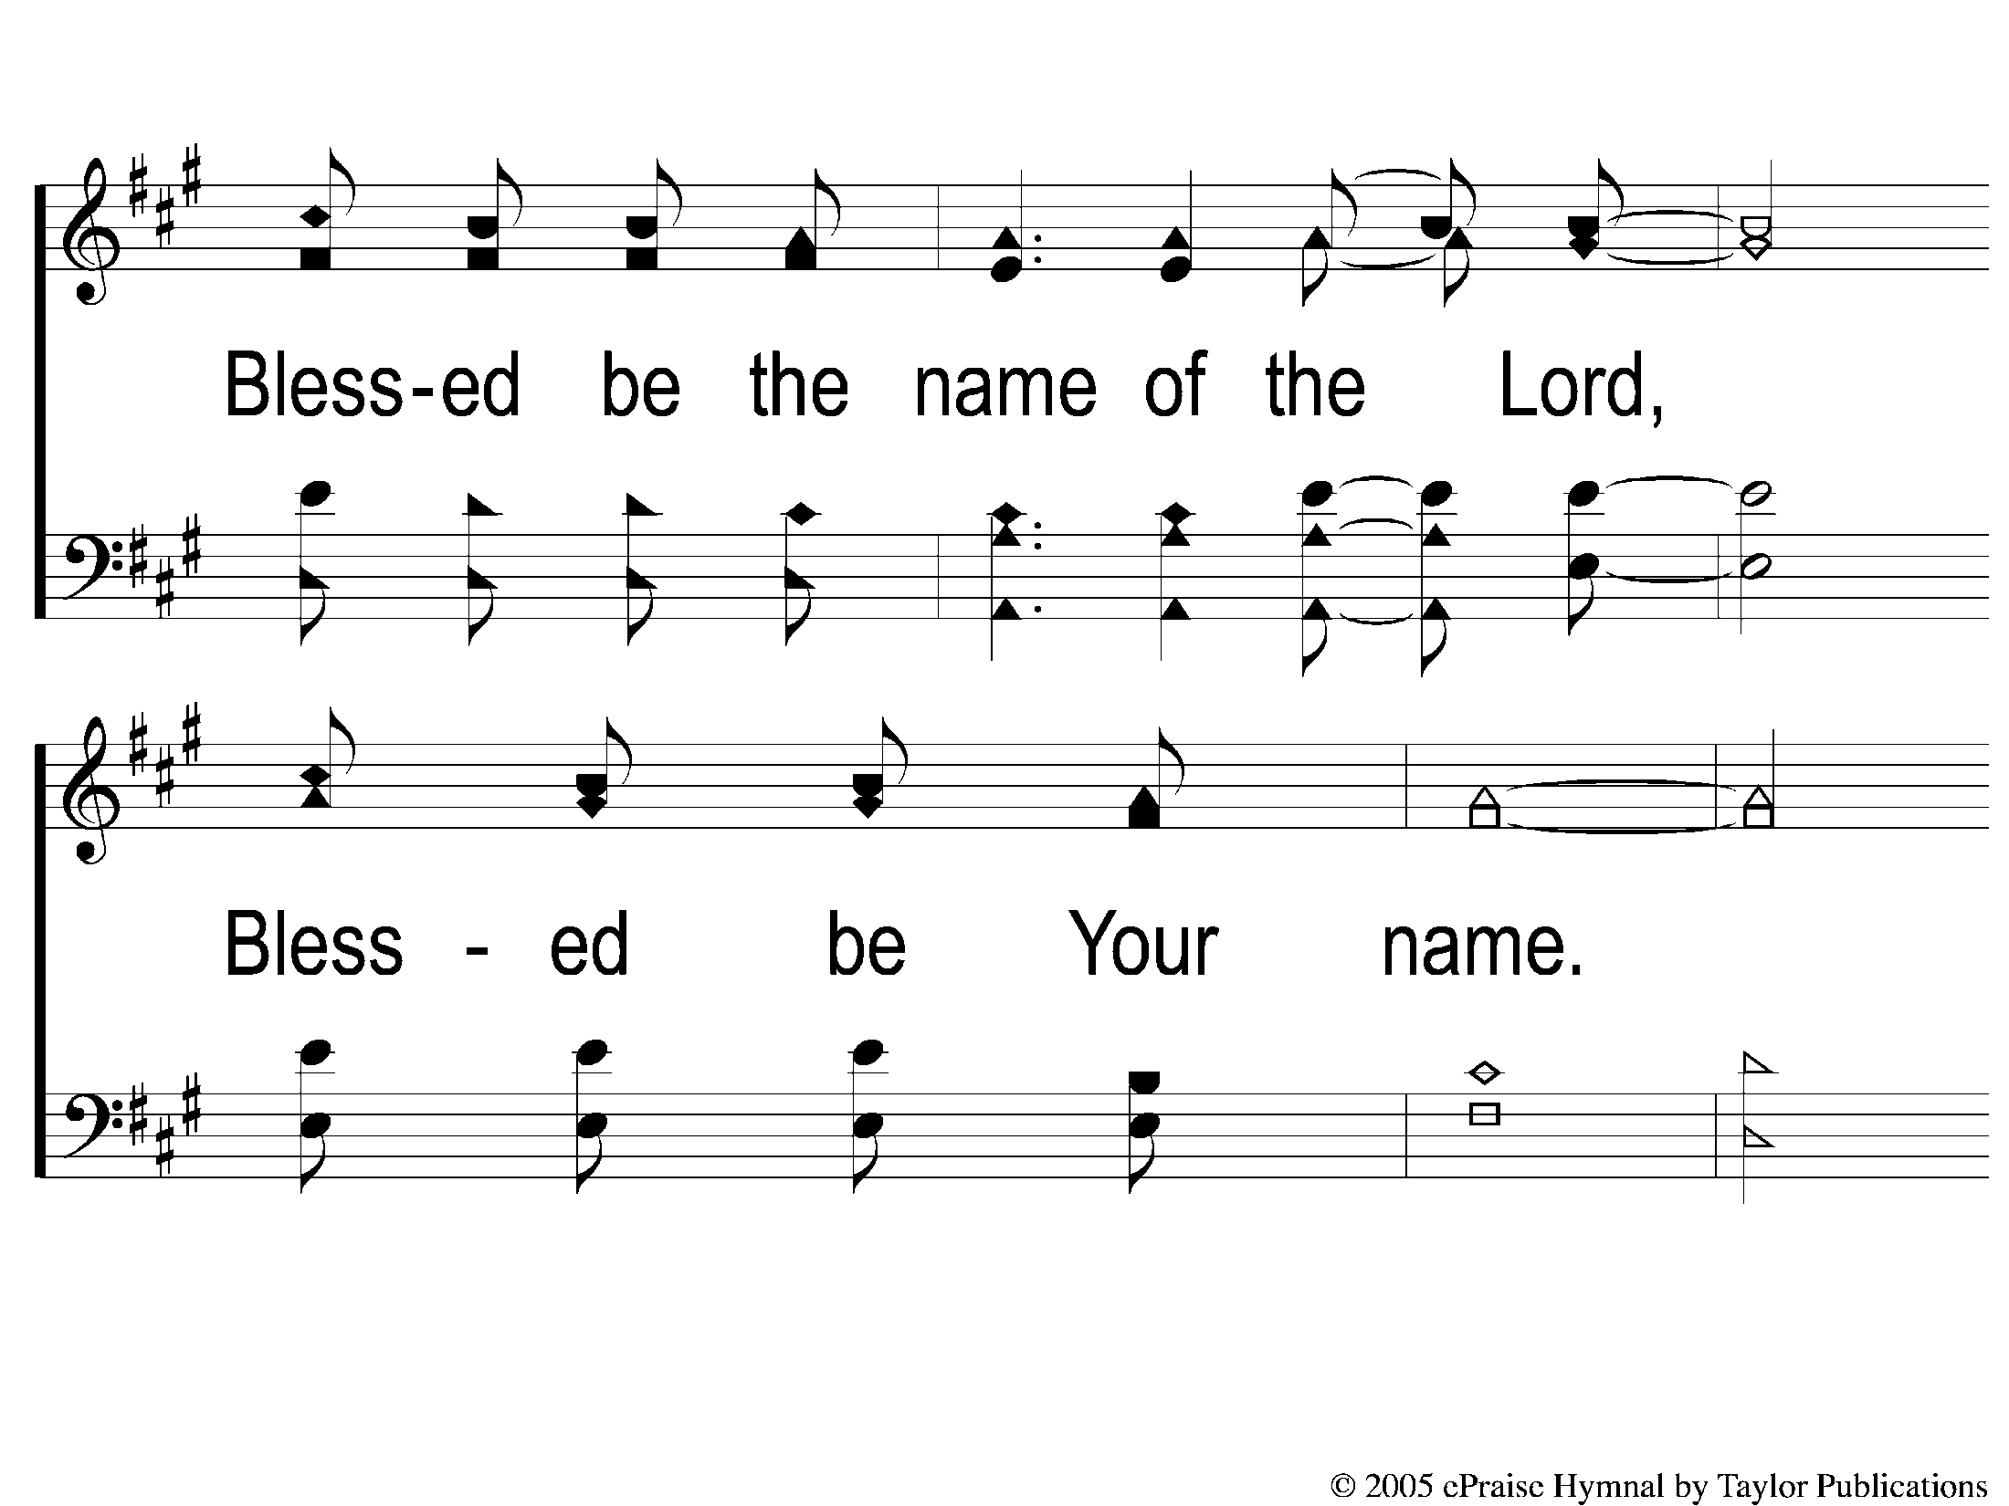
DS1 Blessed Be Your Name
Blessed be Your Name

Slide 14
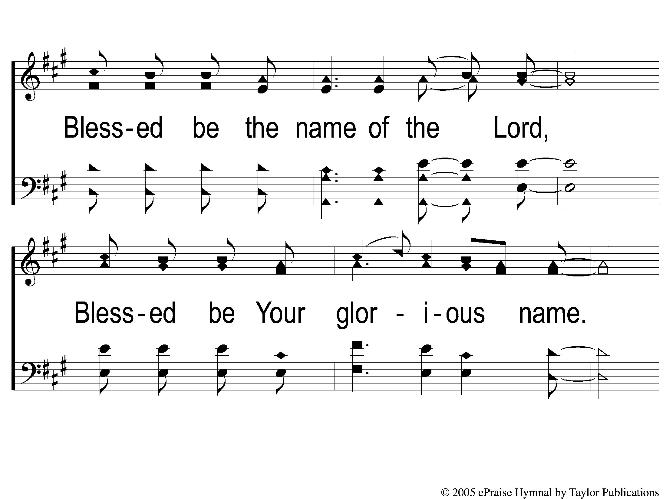
DS2 Blessed Be Your Name
Blessed be Your Name

Slide 15
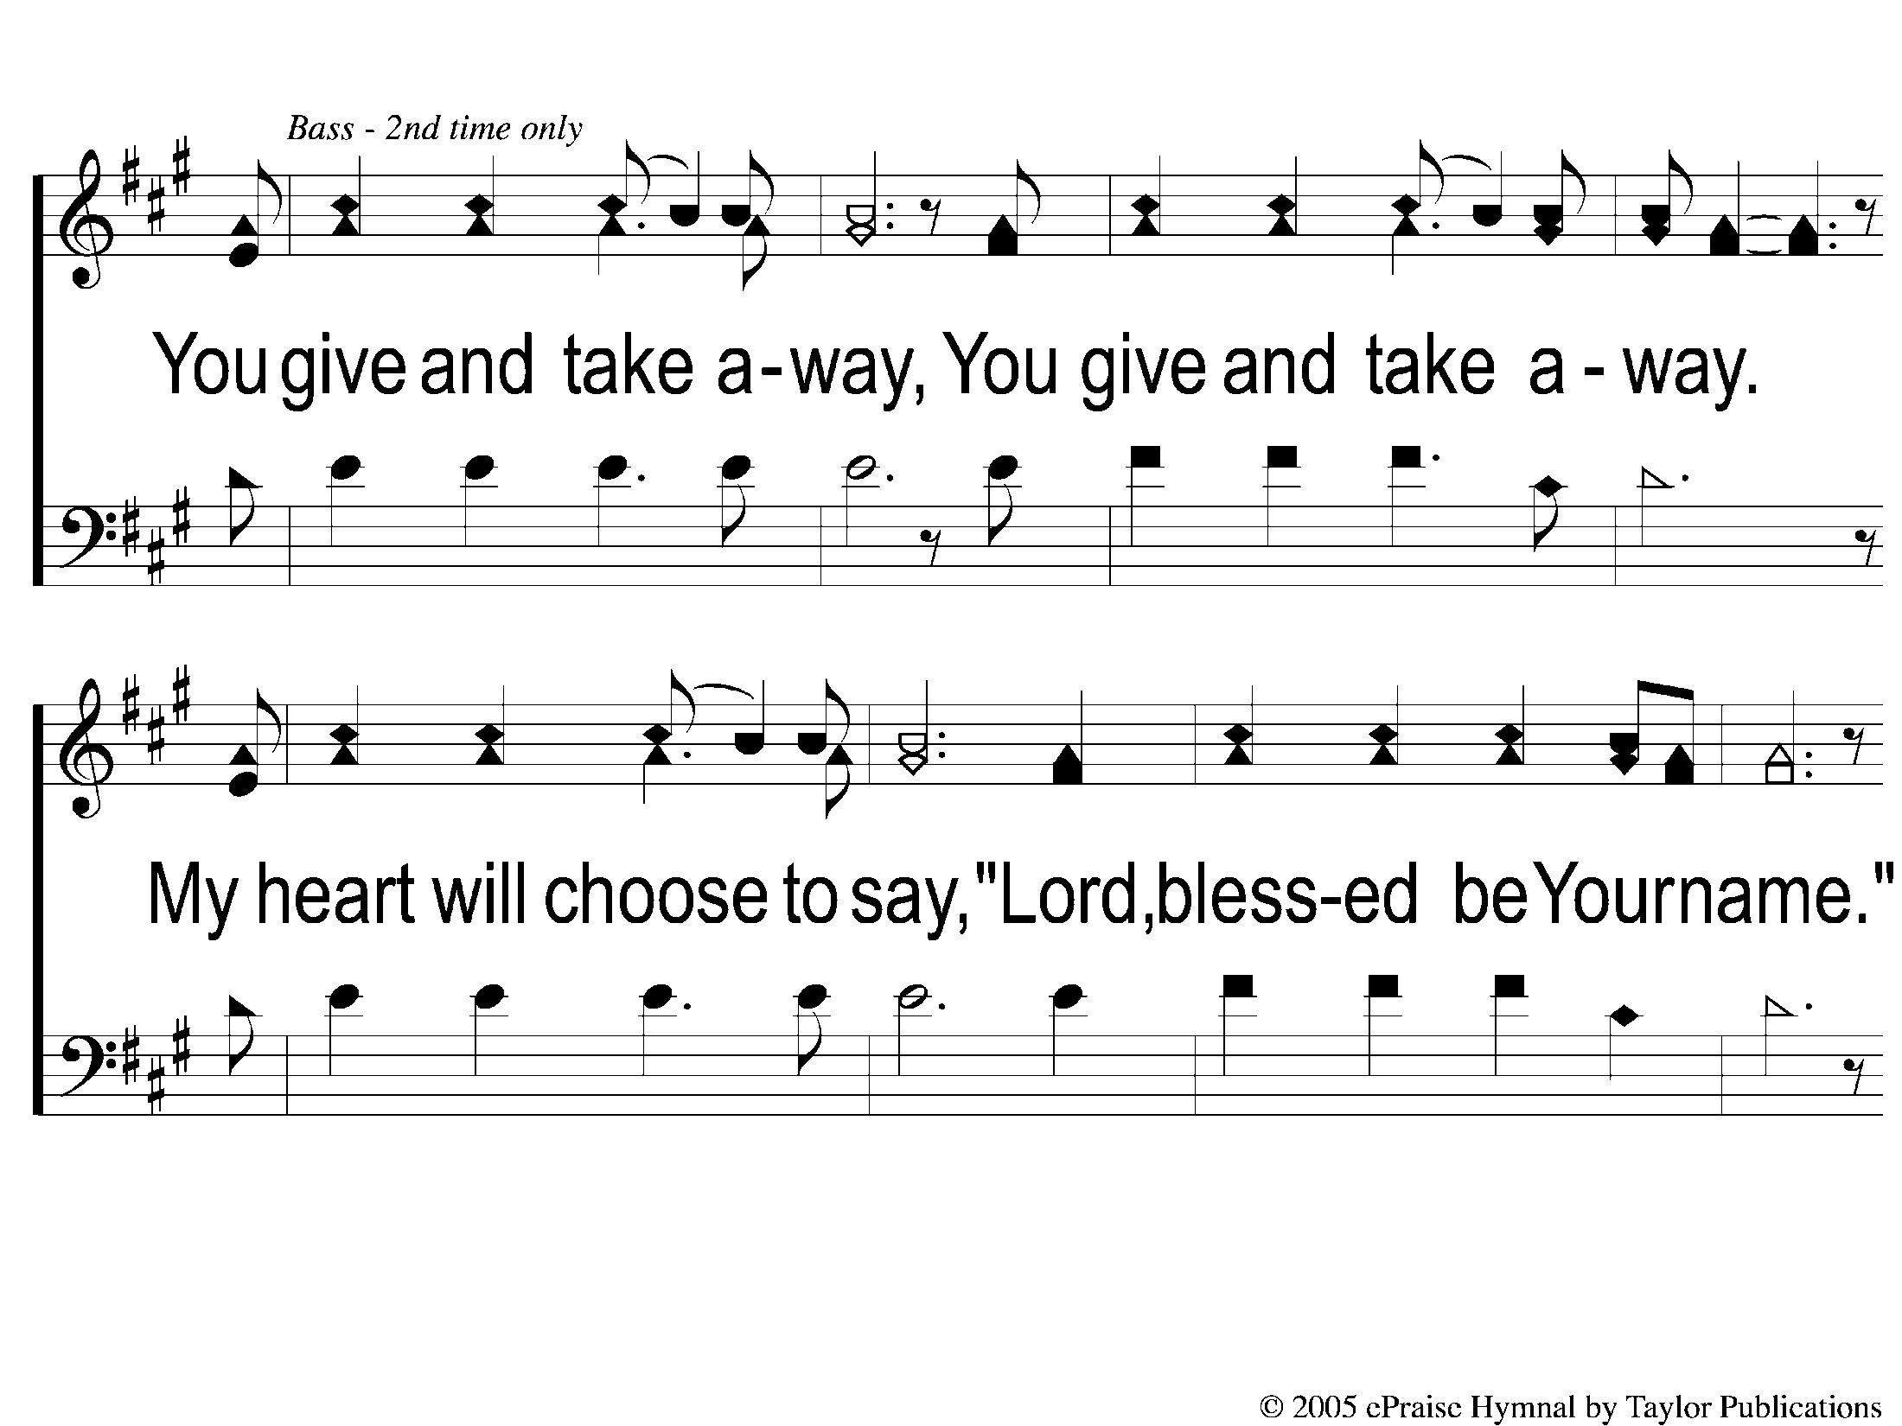
1Bridge1 Trio Blessed Be Your Name
Blessed be Your Name

Slide 16
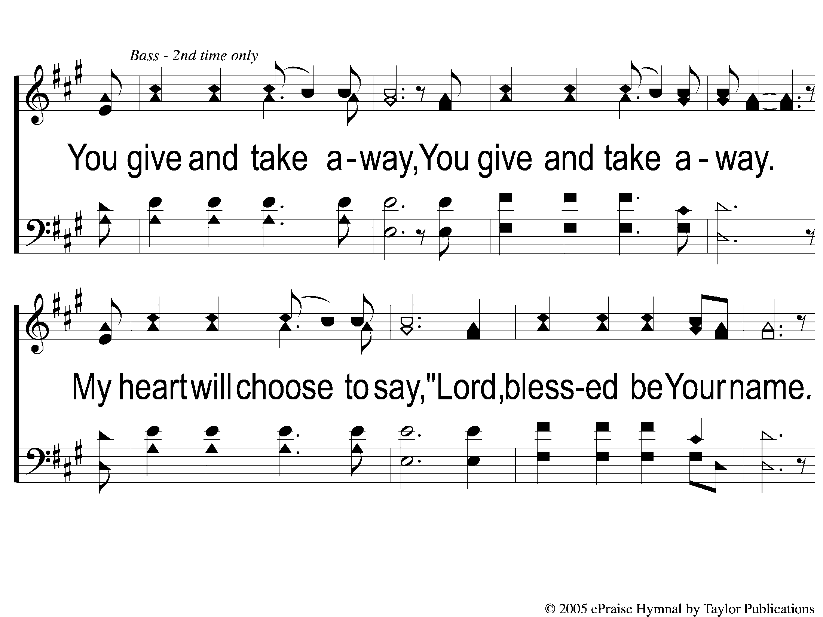
1Bridge2 Blessed Be Your Name
Blessed be Your Name

Slide 17
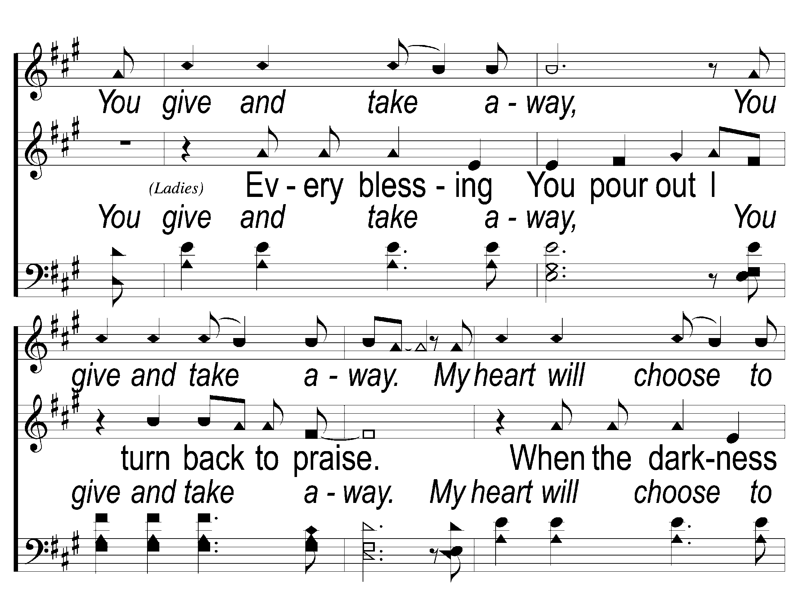
Bridge1 Blessed Be Your Name
Blessed be Your Name

Slide 18
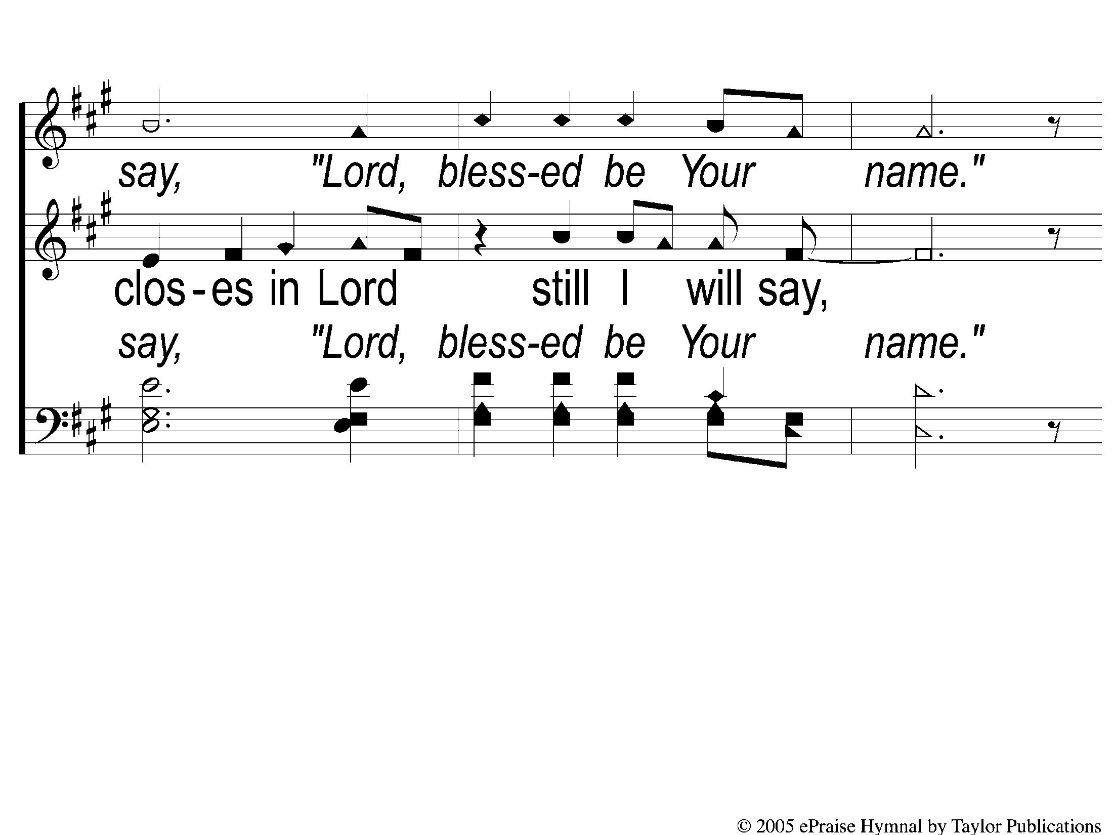
Bridge2 Blessed Be Your Name
Blessed be Your Name

Slide 19
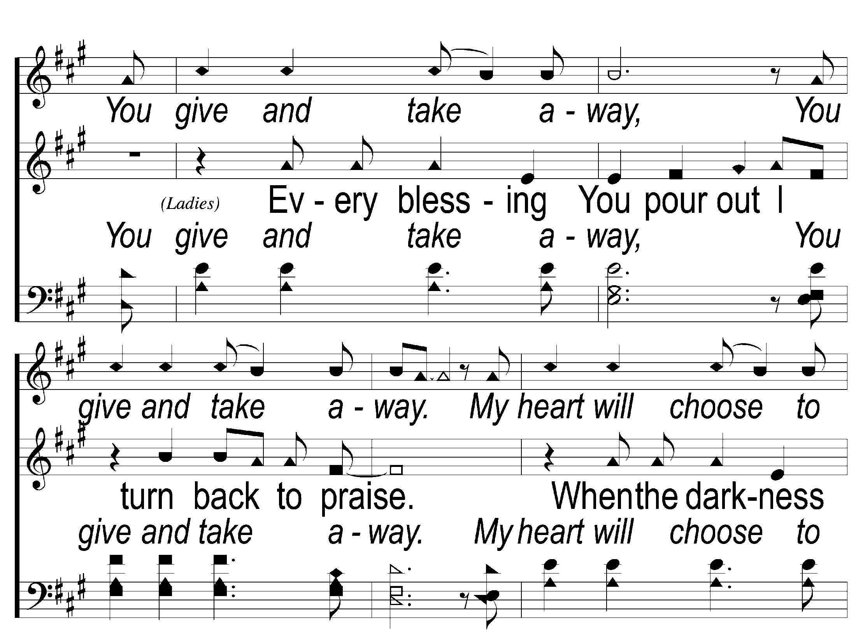
Bridge3 Blessed Be Your Name
Blessed be Your Name

Slide 20
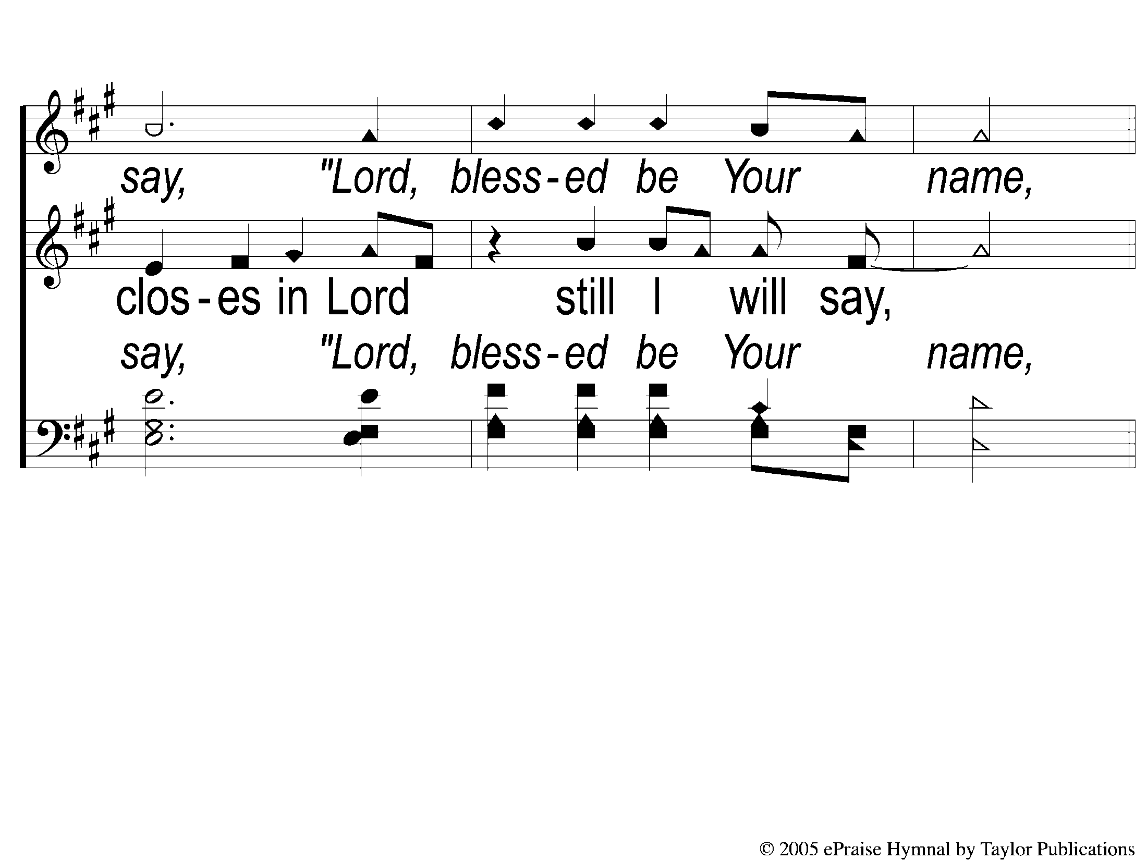
Bridge4 Blessed Be Your Name
Blessed be Your Name

Slide 21
Coda1 Blessed Be Your Name
Blessed be Your Name

Slide 22
Coda2 Blessed Be Your Name
Blessed be Your Name

Slide 23
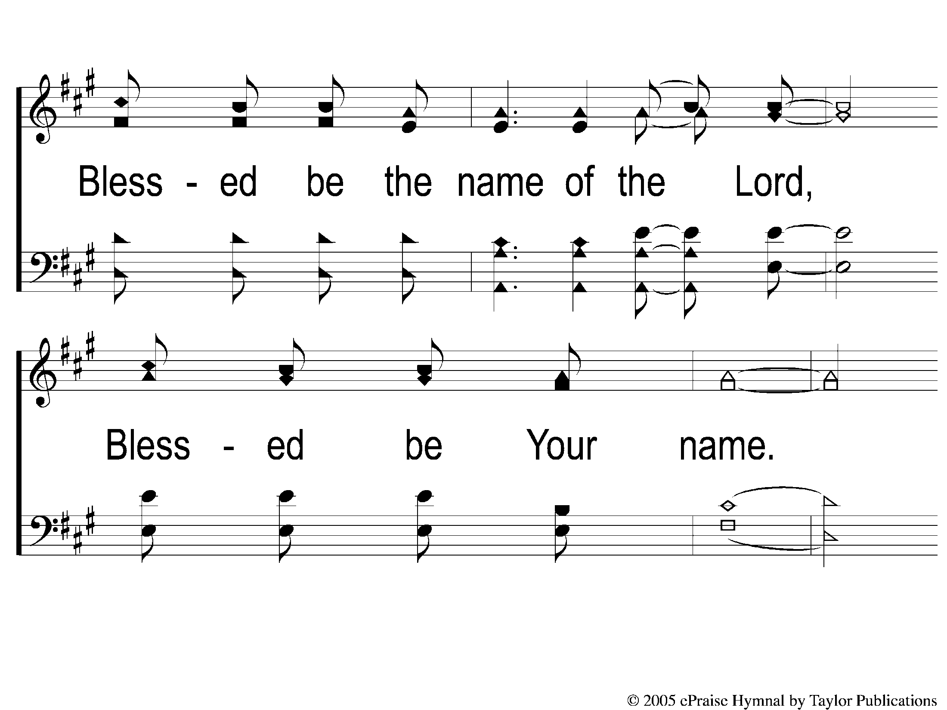
Coda3 Blessed Be Your Name
Blessed be Your Name

Slide 24
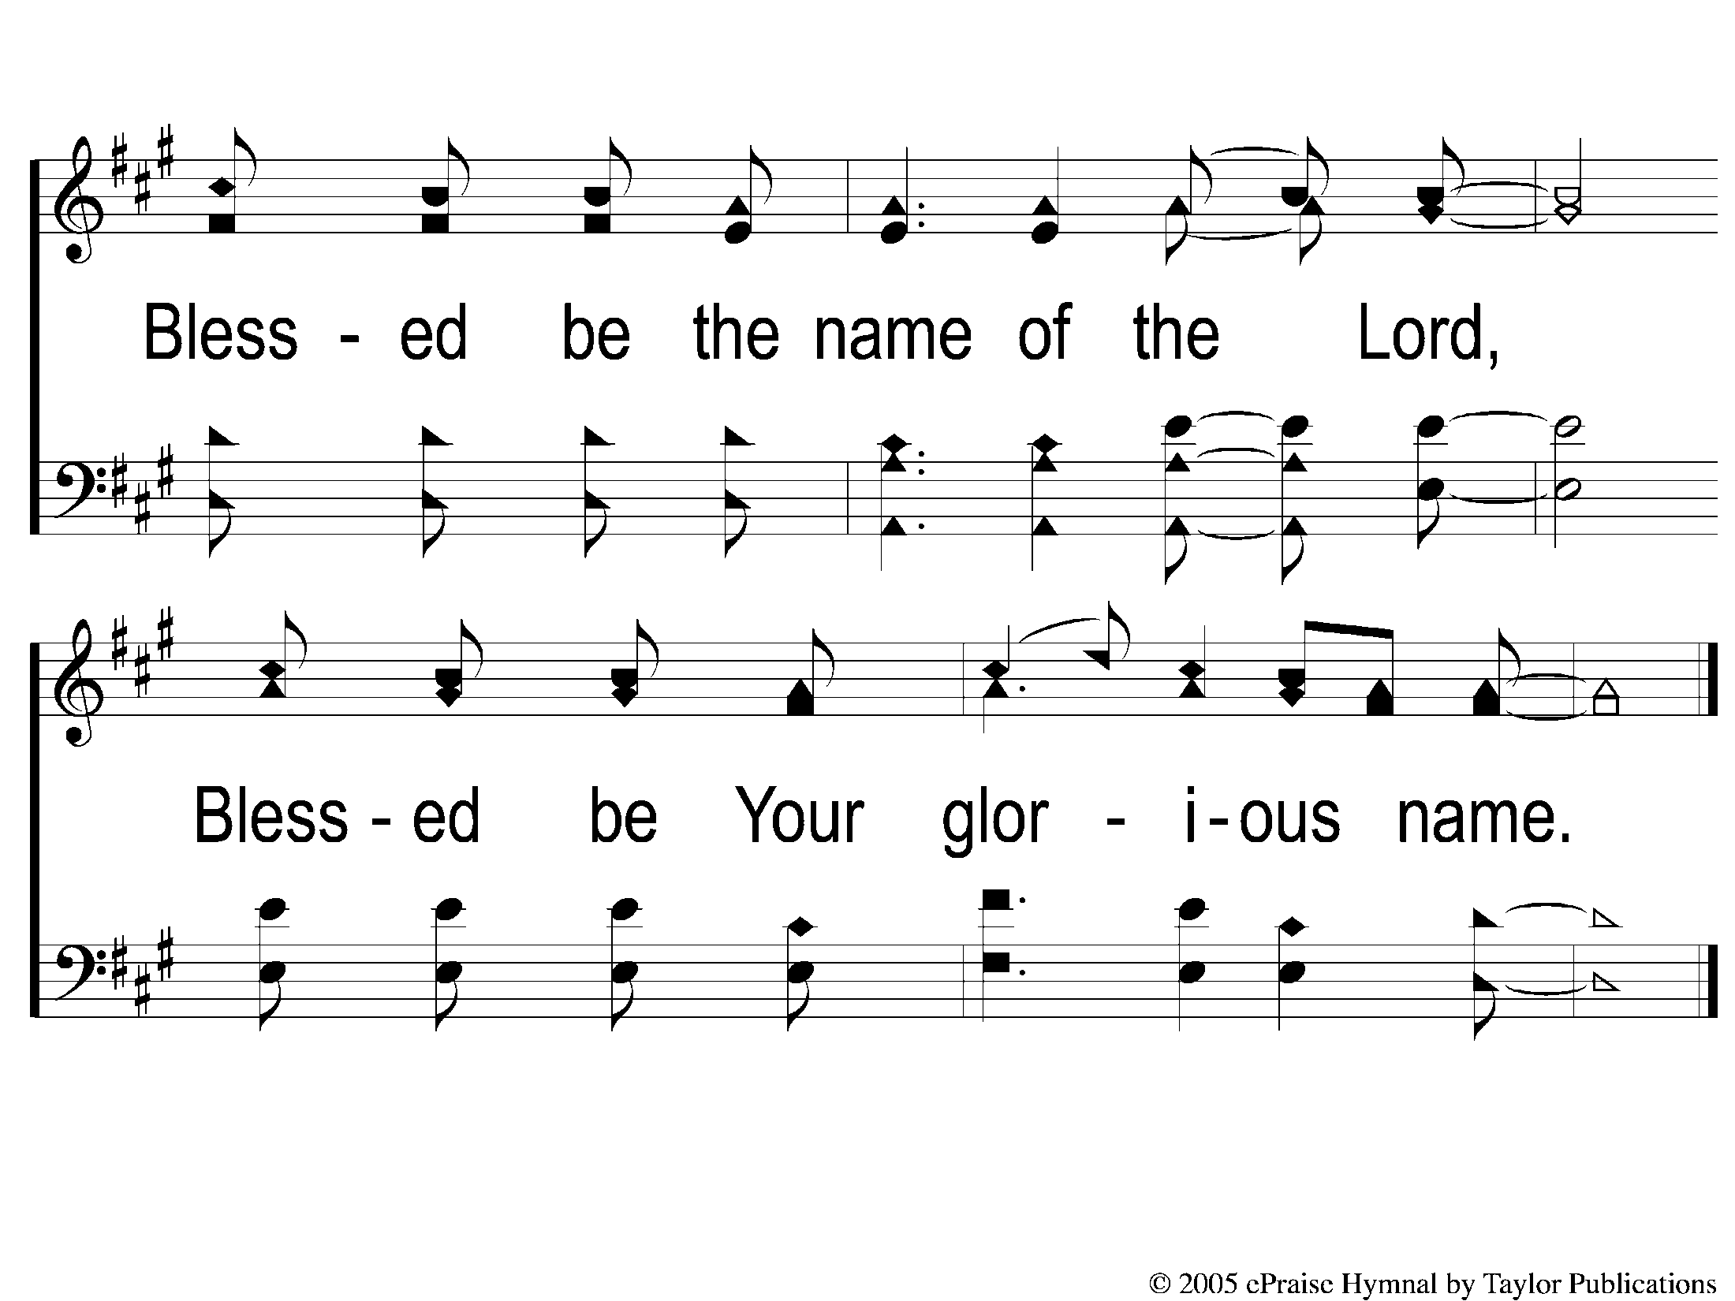
Coda4 Blessed Be Your Name
Blessed be Your Name

